Slide 1

A Combined CNN and LSTM Model for Arabic Sentiment Analysis

Slide 2
Abstract :
The paper addresses the challenge of sentiment analysis for Arabic text, particularly in the context of social media data. It acknowledges the richness and complexity of the Arabic language, along with the scarcity of accurate pre-processing tools and limited research in this area.
Methodology: The study investigates the effectiveness of integrating Convolutional Neural Networks (CNNs) and Long Short-Term Memory (LSTM) networks for Arabic sentiment analysis. It explores different levels of sentiment analysis, including character-level, character n-gram level, and word-level approaches.

Slide 3
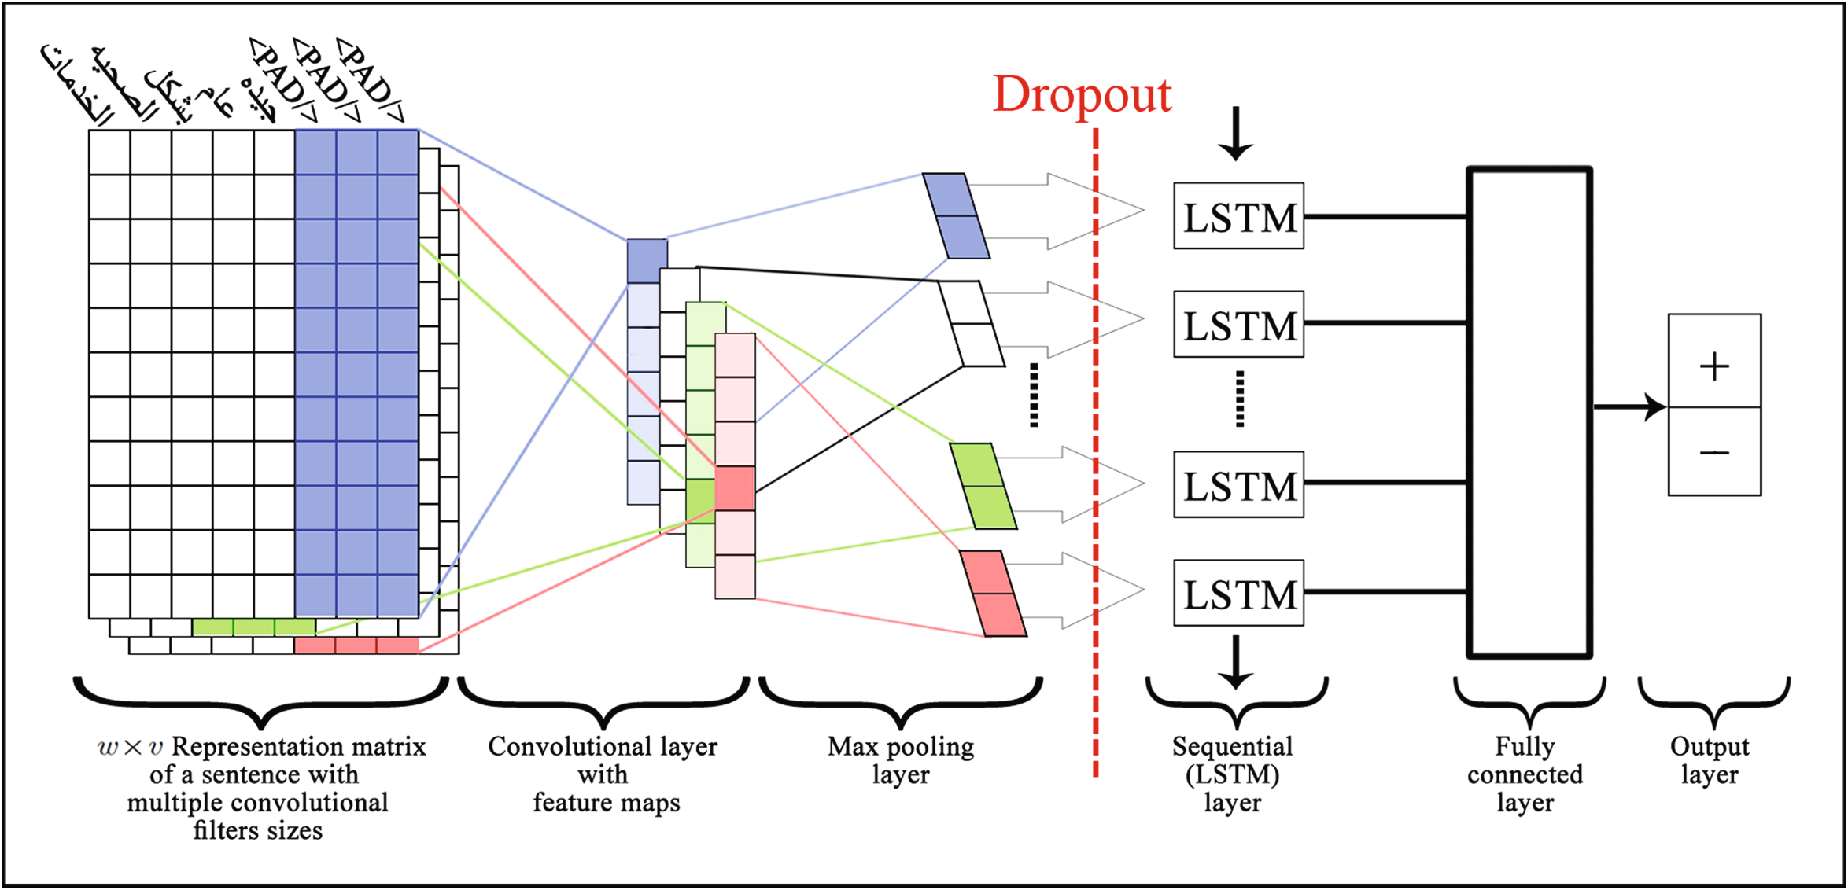
CNN-LSTM Arabic Sentiment Analysis Model:
Architecture of the model including :
input layer
convolutional layer
max-pooling layer
LSTM layer
fully connected layer.

Slide 4
Input layer :
The input to the model consists of pre-processed Arabic text data. Each input sample could be a sequence of characters, character n-grams, or words, depending on the chosen level of analysis.

Slide 5
levels of sentiment analysis :
example Arabic tweet "خدمات الصحة جيدة بشكل عام":
1-Character Level (Char-level):
The tweet is converted into individual characters, where each character represents one feature.
Example: ['خ', 'د', 'م', 'ا', 'ت', ' ', 'ا', 'ل', 'ص', 'ح', 'ة', ' ', 'ج', 'ي', 'د', 'ة', ' ', 'ب', 'ش', 'ك', 'ل', ' ', 'ع', 'ا', 'م']
This level increases the number of features, allowing for more detailed analysis of short tweets and handling variations in word forms.

Slide 6
levels of sentiment analysis :
example Arabic tweet "خدمات الصحة جيدة بشكل عام":
2-Character N-Gram Level (Ch5gram-level):
Words longer than the average length of five characters are split into subwords, while shorter words are retained as they are.
Example with a 5-gram: ['خدما', 'دمات', 'ات ال', ' الصح', 'صحة ', 'ة جيد', ' جيدة', 'جيدة ', 'يدة ب', 'دة بش', 'ة بشك', ' بشكل', 'بشكل ', 'شكل ع', 'كل عا', 'ل عام']
This level helps in dealing with various forms of Arabic words, particularly longer ones, and also expands the number of features for analysis.

Slide 7
levels of sentiment analysis :
example Arabic tweet "خدمات الصحة جيدة بشكل عام":
3-Word Level (Word-level):
The tweet is split into individual words using spaces as separators.
Example: ['خدمات', 'الصحة', 'جيدة', 'بشكل', 'عام']
This level, commonly used in sentiment analysis, divides the text into words for easier interpretation and analysis, albeit potentially losing some character-level nuances.

Slide 8
Convolutional Layer:
The CNN component of the model is responsible for learning spatial hierarchies of features from the input text data. Convolutional filters slide over the input data, extracting local patterns and features. This layer captures information such as word morphology and character combinations, which are crucial for understanding sentiment in Arabic text.

Slide 9
Max-Pooling Layer:
After the convolutional layer, max-pooling is applied to down-sample the feature maps obtained from the convolutional operation. Max-pooling extracts the most salient features from each feature map, reducing the dimensionality of the data while retaining important information. This helps in capturing the most relevant features for sentiment analysis.

Slide 10
LSTM Layer:
Following the CNN component, the LSTM network is utilized to capture long-range dependencies and temporal dynamics in the input text sequences. LSTM units maintain a memory state that allows them to remember and selectively forget information over time. This is particularly useful for analyzing sentiment in text, as it enables the model to capture contextual information and semantic relationships between words.

Slide 11
Fully Connected Layer:
The output from the LSTM layer is fed into a fully connected layer, which acts as a classifier. This layer aggregates the learned features from the preceding layers and maps them to the corresponding sentiment labels (e.g., positive, negative, neutral). Through training, the model learns to associate specific patterns in the input text with different sentiment categories, enabling it to make accurate predictions on unseen data.

Slide 12
Experiment :
Experiment evaluated a multi-input CNN model for Arabic sentiment analysis on the Ar-Twitter dataset containing 66,666 positive and negative tweets. The text data was preprocessed into character, word, and 5-gram character representations.
The CNN model architecture had parallel convolutional layers for each input representation, followed by LSTM layers and concatenation. It was trained for 1 epoch with 20% validation data.
Classification reports showed high precision in detecting the correct class but lower recall, missing some true positives/negatives. Combining multiple text representations benefited performance.
Results:
Overall validation accuracy: 87.21%
Test set accuracy on negative tweets: 87.81%
Test set accuracy on positive tweets: 86.39%

Slide 13
Results :
Sentiment Level | Main-AHS | Sub-AHS | Ar-Twitter | ASTD | negative tweets | positive tweets
Char-level | 0.8941 | 0.9164 | 0.8131 | 0.7419 | 0.903 | 0.810
Ch5gram-level | 0.9163 | 0.9568 | 0.8283 | 0.7762 | 0.904 | 0.807
Word-level | 0.9424 | 0.951 | 0.881 | 0.7641 | 0.903 | 0.810
Metric | Value
Overall Validation Accuracy | 87.21%
Test Set Accuracy on Negative Tweets | 87.81%
Test Set Accuracy on Positive Tweets | 86.39%

Slide 14
Classification Report Summary:
Sentiment Level | Precision | Recall | F1-Score
Negative - Char | 1.00 | 0.83 | 0.91
Negative - Word | 1.00 | 0.83 | 0.90
Negative - 5gram Char | 1.00 | 0.83 | 0.90
Positive - Char | 1.00 | 0.90 | 0.95
Positive - Word | 1.00 | 0.90 | 0.95
Positive - 5gram Char | 1.00 | 0.90 | 0.95

Slide 15
Conclusion
The combined CNN and LSTM model with different sentiment analysis levels demonstrated improved performance in Arabic sentiment classification tasks. Specifically, the Word-level approach generally provided the highest accuracy across most datasets, except for the ASTD dataset where the Ch5gram-level approach performed best. This hybrid model outperformed some of the previous methods on several datasets, showcasing the effectiveness of integrating CNN and LSTM networks for this task.

